Slide 1
What is estimation and inference?
Dr. Tirthajyoti Sarkar
August 31st, 2019

Slide 2
Estimation
In statistics, estimation refers to the process by which one makes inferences about a population, based on information obtained from a sample.
Point estimate: A point estimate of a population parameter is a single value of a statistic. For example, the sample mean x is a point estimate of the population mean μ.
Interval estimate: An interval estimate is defined by two numbers, between which a population parameter is said to lie. For example, a < x < b is an interval estimate of the population mean μ.
Example: “What is the average age of all on-road private cars in the United States?”. We cannot count all cars’ age. So, we pick random sample from every state, or a large number of counties all over the nation and calculate the mean. Even then, we may not be sure and only can give an interval: 7 < average_age < 12

Slide 3
Confidence interval
Statisticians use a confidence interval to express the precision and uncertainty associated with a particular sampling method. A confidence interval consists of three parts.
A confidence level.
A statistic (quantity calculated in a sample to estimate a value in a population)
A margin of error.
The confidence level describes the uncertainty of a sampling method. The statistic and the margin of error define an interval estimate that describes the precision of the method. The interval estimate of a confidence interval is defined by the sample statistic + margin of error.

Slide 4
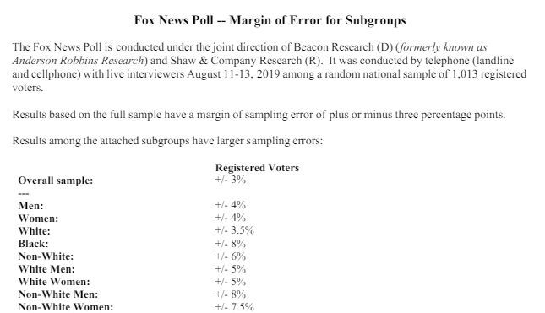
Margin of error
If the pollster used a method that contains the parameter 95% of the time it is used, he or she would arrive at the following 95% confidence interval: 0.46 < X < 0.60. The pollster would then conclude that somewhere between 46% and 60% of the population has the statistic X. The media usually reports this type of result by saying that 53% has the particular statistic with a margin of error of 7%.

Slide 5
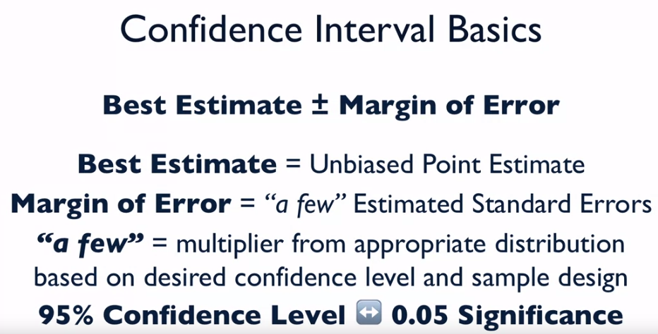
So, here is the summary of confidence interval

Slide 6
Food for thought on the confidence interval
Suppose, you are sampling some data from a population of students to estimate their probability of success in a standardized test (e.g. SAT).
QUESTION 1: If you are allowed to sample only 10 students, would your estimation interval be narrow or wide than if you would have been allowed a sample of 100 students?
QUESTION 2: If you are asked to construct a 99% confidence interval vs. a 90% confidence interval for the estimated mean, which one would be wider (on the same sample dataset)?
We will simulate these scenarios in the coding exercise and see the answers!

Slide 7
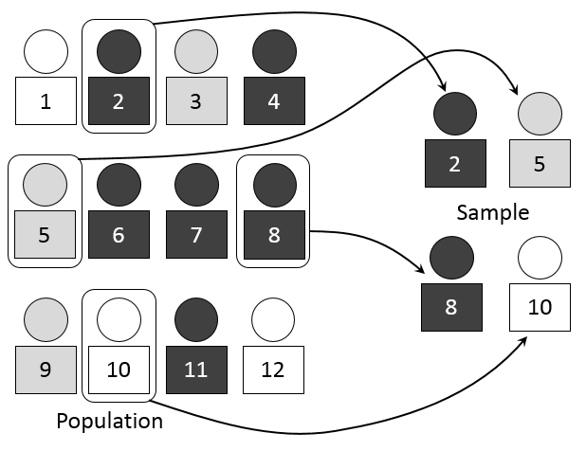

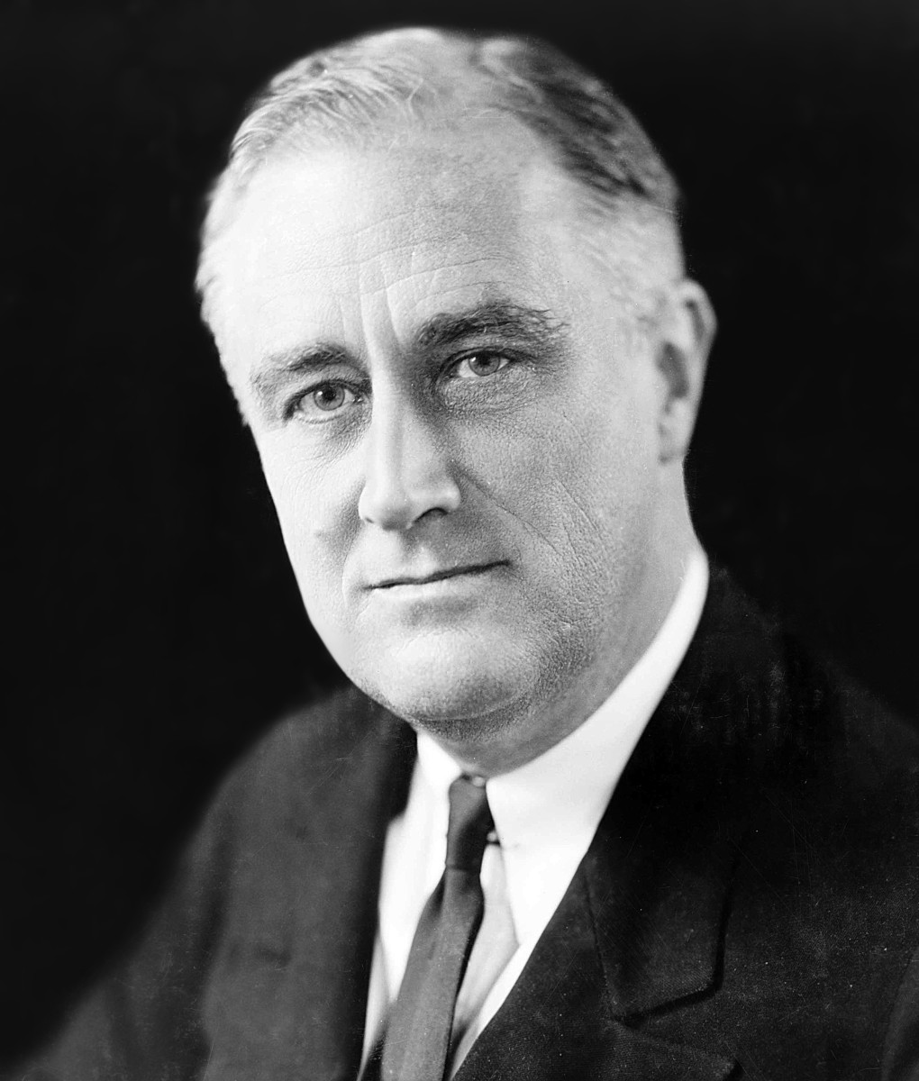
Sampling
Simple random sampling
Systematic (order-based) sampling
Stratified sampling
Probability-proportional-to-size sampling
Cluster sampling
Sampling with/without replacement
Common sense sampling :-)
https://www.math.upenn.edu/~deturck/m170/wk4/lecture/case1.html

Slide 8
Degrees of freedom
Some estimates are based on more information than others.
For example, an estimate of the variance based on a sample size of 100 is based on more information than an estimate of the variance based on a sample size of 5.
The degrees of freedom (df) of an estimate is the number of independent pieces of information on which the estimate is based.
In general, the degrees of freedom for an estimate is equal to the number of data points minus the number of parameters estimated en route to the estimate in question.
Suppose, to estimate variance of the age of the cars, we take 5 cars. Is the degrees of freedom 5? NO. Because to compute variance we need mean. But we do not have population mean. We first estimate/replace it by sample mean. So, df = 5 -1 = 4.

Slide 9
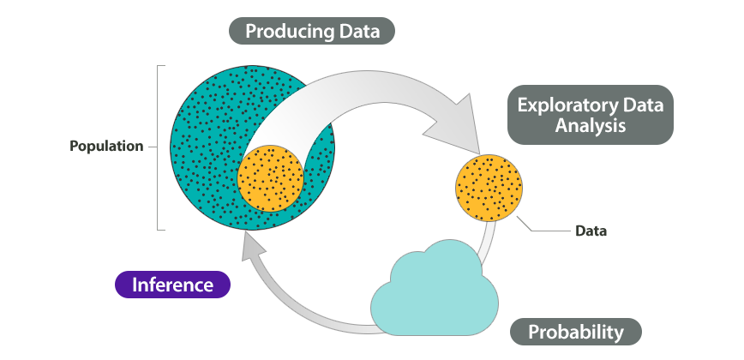
Inferential statistics
The branch of statistics concerned with drawing conclusions about a population from a sample, which is drawn from that population.
This is generally done through random sampling, followed by inferences made about central tendency, or any of a number of other aspects of a distribution.
So, the process of inference encompasses the estimation method completely.
However, the end goal of inference is not only just compute/estimate population statistics but to understand deeply the ‘nature’ of the population i.e. what probability distribution (or what combination) the data came from.

Slide 10
Hypothesis testing, p-values, statistical significance
Dr. Tirthajyoti Sarkar
August 31st, 2019

Slide 11
Why test hypotheses?
When interpreting an experimental finding, a natural question arises as to whether the finding could have occurred by chance.
Hypothesis testing is a statistical procedure for testing whether chance is a plausible explanation of an experimental finding (or trend from observational data set).
NULL Hypothesis (informal definition): If we are trying to establish a causation from data, in most cases, we start by assuming that the cause is not present. This is not interesting and is called NULL hypothesis (H₀). The cause is the ALTERNATE hypothesis (H_{a}).
Then, if we can show, from the data, that the chance of observing the data is extremely small if the original cause/trend was not present, then we reject the NULL hypothesis.

Slide 12
The link between descriptive and inferential statistics
Hypothesis testing
Chance of effect/ observed data
Statistical inference
Science of chance: Probability
All the machinery of descriptive stat

Slide 13

“My name is Bond… James Bond”
Stirred or shaken?
Suppose we gave Mr. Bond a series of 16 taste tests. In each test, we flipped a fair coin to determine whether to stir or shake the martini.
Then we presented the martini to Mr. Bond and asked him to decide whether it was shaken or stirred.
Let's say Mr. Bond was correct on 13 of the 16 taste tests.
Does this prove that Mr. Bond has at least some ability to tell whether the martini was shaken or stirred?

Slide 14
Was 007 just lucky or he has it in him?
Mr. Bond could have been just lucky and guessed right 13 out of 16 times. But how plausible is the explanation that he was just lucky?
To assess its plausibility, we determine the probability that someone who was just guessing would be correct 13/16 times or more. This probability can be computed from the binomial distribution, and the binomial distribution calculator shows it to be 0.0106.
This is a pretty low probability, and therefore someone would have to be very lucky to be correct 13 or more times out of 16 if they were just guessing. So either Mr. Bond was very lucky, or he can tell whether the drink was shaken or stirred.
The hypothesis that he was guessing is not proven false, but considerable doubt is cast on it. Therefore, there is strong evidence that Mr. Bond can tell whether a drink was shaken or stirred.

Slide 15
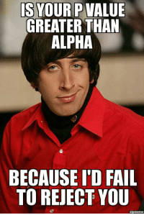

P-value and statistical significance
In hypothesis testing, the p-value or probability value is, for a given statistical model, the probability that, when the null hypothesis is true, the statistical summary would be equal to, or more extreme than, the actual observed results.
In the previous example, the probability value is the probability of an outcome given the hypothesis. It is not the probability of the hypothesis given the outcome.
Statistical significance is a predetermined level, below which we reject the NULL hypothesis. A popular value is p=0.05.

Slide 16
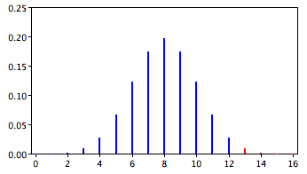
One-tailed and two-tailed tests
Right chart shows the binomial distribution for the test with Mr. James Bond.
The distribution is symmetrical. So, the probability of getting 3 right is equal to getting 13 right out of 16.
We use one-tailed/two-tailed tests depending on the research question.
“Whether Mr. Bond can tell the difference between shaken or stirred martinis” - 2-tailed.
“Whether Mr. Bond is better than chance at determining whether a martini is shaken or stirred.” - 1-tailed.
Notes:
Should the one-tailed or the two-tailed probability be used to assess Mr. Bond's performance? That depends on the way the question is posed. If we are asking whether Mr. Bond can tell the difference between shaken or stirred martinis, then we would conclude he could if he performed either much better than chance or much worse than chance. If he performed much worse than chance, we would conclude that he can tell the difference, but he does not know which is which. Therefore, since we are going to reject the null hypothesis if Mr. Bond does either very well or very poorly, we will use a two-tailed probability.
The null hypothesis for the two-tailed test is π = 0.5. By contrast, the null hypothesis for the one-tailed test is π ≤ 0.5. Accordingly, we reject the two-tailed hypothesis if the sample proportion deviates greatly from 0.5 in either direction. The one-tailed hypothesis is rejected only if the sample proportion is much greater than 0.5. The alternative hypothesis in the two-tailed test is π ≠ 0.5. In the one-tailed test it is π > 0.5.

Slide 17
Common examples of statistical inference in play
Drug efficacy testing (“This new medicine trial shows 20% more effectiveness over the current best one”)
Advertising claims (“My product/service/ad reduces the cost of business by 15% on average/increases the click-through rate by > 30%”)
Scientific discovery claims (“My research group claims with 99% confidence that this gene is the root cause behind this disease” )
Political polls (“There is a 7 percentage points difference between the means of the groups who support this candidate vs. those who don’t, p-value is < 0.05”)
Your online behavior. Google, Amazon, Facebook are constantly subjecting you, the consumer, to A/B testing, which is another form of hypothesis testing. (“Showing this recommendation increased the revenue vs. the alternative one.”)

Slide 18
More about significance testing
When a researcher concludes that the null hypothesis is false, the researcher is said to have rejected the null hypothesis. The probability value below which the null hypothesis is rejected is called the α (alpha) level or simply α. It is also called the significance level.
Do not confuse statistical significance with practical significance. A small effect can be highly significant if the sample size is large enough. A feature in a dataset may have very low p-value but a weak impact on the outcome.
Two traditional approaches - Fisher and Pearson. Fisher’s approach is more suitable for scientific analysis, whereas Pearson’s approach is more suitable for Yes/No decision making situations.
Be aware of “p-hacking” in scientific/technical literature. People tend to report only the statistically significant results. But do they report all the failures?

Slide 19
Type-I/II errors, nature of statistical learning
Dr. Tirthajyoti Sarkar
August 31st, 2019

Slide 20
Type-I and Type-2 errors
Type I error occurs when a significance test results in the rejection of a true null hypothesis. Type I error rate is affected by the significance level (α) - the lower the α level, the lower the Type I error rate.
Note, α is NOT the probability of a Type I error. It is simply the probability of a Type I error given that the null hypothesis is true. If the null hypothesis is false, then it is impossible to make a Type I error.
Type-II error occurs when we fail to reject a false null hypothesis. If the null hypothesis is false, then the probability of a Type II error is called β (beta). The probability of correctly rejecting a false null hypothesis equals 1- β and is called statistical power.
In the parlance of
Notes:
When a statistical test is not significant, it means that the data do not provide strong evidence that the null hypothesis is false. Lack of significance does not support the conclusion that the null hypothesis is true. Therefore, a researcher should not make the mistake of incorrectly concluding that the null hypothesis is true when a statistical test was not significant. Instead, the researcher should consider the test inconclusive. Contrast this with a Type I error in which the researcher erroneously concludes that the null hypothesis is false when, in fact, it is true.

Slide 21
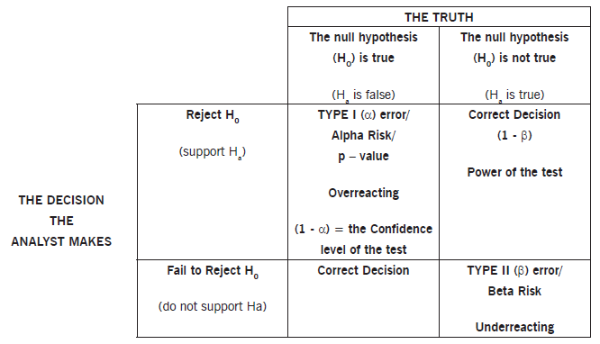
Chart of the errors

Slide 22
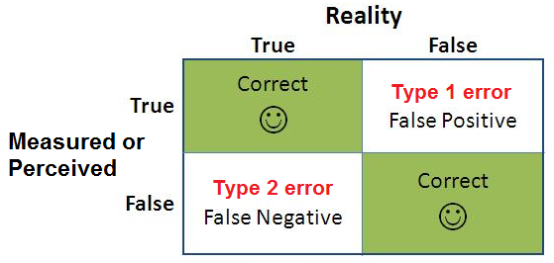
In terms of confusion matrix (popular in ML)

Slide 23
Statistical learning vs. Machine learning
The process or machinery of the statistical-inference-based learning is somewhat opposite to the general principle of machine learning, as we understand and practice it.
In ML, we follow (or want to follow) inductive generalization i.e. given the data we want to learn some general truth. In statistical learning/inference, we assume a known truth/distribution and computes the probability of data not supporting that truth/not coming from that distribution.
Linear regression
Statistical learning
Logistic regression/classification
Learning
Decision trees
Machine learning
Deep learning
Notes:
For example, if a statistical analysis were undertaken to determine whether a machine in a manufacturing plant were malfunctioning, the statistical analysis would be used to determine whether or not the machine should be shut down for repair. The plant manager would be less interested in assessing the weight of the evidence than knowing what action should be taken.
There is no need for an immediate decision in scientific research where a researcher may conclude that there is some evidence against the null hypothesis, but that more research is needed before a definitive conclusion can be drawn.

Slide 24
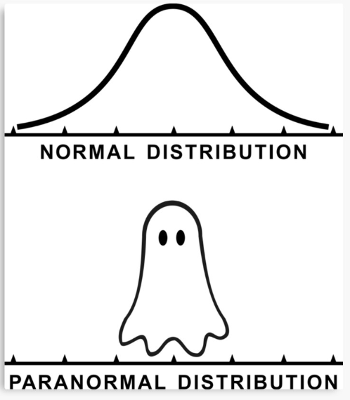
A practical illustration of how “we assume a truth”
A large body of process control, quality assurance, and reliability testing in manufacturing depends on the concept of ‘six-sigma’. Thousands of managers and engineers live by this principle everyday.
Related theory depends on the preconceived notion that the data points are coming from a perfect Gaussian distribution.
What if the underlying distribution is not a Gaussian Normal?

Slide 25
You need both skills to do well in data science
You need sound background in conventional statistical analysis, modeling, and inference techniques to answer important questions for your business and product.
Statistical learning/inference skills will give you ability to reject myths, unscientific claims, and get the most truth out of the given data. It gives you ability to choose between alternatives, which is almost always what businesses are doing to maximize value to shareholders.
You also need to acquire machine learning skills to be able to predict and learn continuously based on the data that is always coming at you.
We will also see, how another branch of statistical learning - Bayesian inference - is more aligned to the machine learning machinery learn and update model based on new data.

Slide 26
Ensemble thinking
A research study on the effectiveness of anxiety drug finds that the treatment group’s mean anxiety is lower than the control group (placebo was given). But the p-value came 0.11 - a difference as large or larger than the one obtained in the experiment would occur 11% of the time even if there were no true difference between the treatments.
A naive researcher would fail to reject the NULL hypothesis (there is no difference) and will not be excited. A seasoned researcher will be excited to see lower mean in the treatment group and repeat the experiment.
Second time, suppose the treatment group again showed lower mean anxiety with p-value of 0.07. The naive researcher would think “wow two tests, both showed non-significant results!”. The seasoned researcher would be more excited to get repetitive results of lower mean anxiety and combine the results. If combined, the p-value will be < 0.05.
This approach of updating the belief is also the hallmark of Bayesian thinking.

Slide 27
Hypothesis test example, comparing means, ANOVA
Dr. Tirthajyoti Sarkar
August 31st, 2019

Slide 28
Significance testing and confidence interval
There is a close relationship between confidence intervals and significance tests. Specifically, if a statistic is significantly different from 0 at the 0.05 level, then the 95% confidence interval will not contain 0.
All values in the confidence interval are plausible values for the parameter, whereas values outside the interval are rejected as plausible values for the parameter.
As we saw before, the confidence interval of a test statistic widen with lower significance level i.e. the confidence interval will be wider if alpha = 0.01 vs. alpha = 0.05.

Slide 29
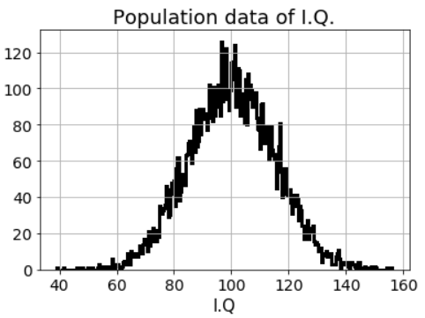
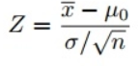
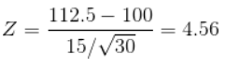
A simplistic illustration
A principal at a certain school claims that the students in his school are above average intelligence. A random sample of 30 students have a mean score of 112.5. Is there sufficient evidence to support the principal’s claim? The mean population IQ is 100 with a standard deviation of 15.
Step 1: Null hypothesis. The accepted fact is that the population mean is 100, so: H₀: μ=100.
Step 2: The claim is that the students have above average IQ scores, so:H_{a}: μ > 100. The fact that we are looking for scores “greater than” a certain point means that this is a one-tailed test.
Step 3: State the alpha level. If not given, use 5% (0.05).
Step 4: Find the rejection region area from a stats table or function.
Step 5: Compute the test statistic and compare this to the rejection area. In this case, because population distribution is assumed to be Normal, we have to use z-score as the test statistic.
Step 6: If z-score is greater than the rejection area, reject the NULL hypothesis. In this case, rejection area is 1.645 and we reject the H₀.

Slide 30
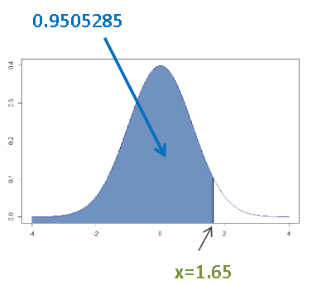
How to get the rejection area?
For a standard normal curve (mean = 0 and standard deviation = 1), it is simply the area under the curve for a particular x-value.
Do not confuse it with the 3-sigma (68-95-99.7) rule. That maxim assumes the mean is located at 50% or 0.5, not 0.
Z-table is a special table which lets you look up the x-value if you know the area (corresponding to the significance level) or vice-versa.
In the previous example, the alpha = 0.05, so we look for x-value which gives 95% (1-0.05 = 0.95) area.

Slide 31
What happens if the population properties, sample characteristics, or the test criteria change
What happens to our conclusion if the population mean is higher, say 105?
What happens to our conclusion if the population standard deviation is lower, say 10? What happens if it is higher instead?
What happens if there were only 8 high-school students who could be tested for the I.Q.? What if we could test 100 students instead?
What is the impact of changing the significance level to 0.01 from 0.05?

Slide 32
Comparing means
A majority of statistical experiments are designed to compare means. The experiment may involve only one sample mean that is to be compared to a specific value. Or the experiment could be testing differences among many different experimental conditions, and the experimenter could be interested in comparing each mean with each of the other means.
Depending on the sample size, we can use t-test or z-test for this purpose.
Degrees of freedom will be important to consider.
A/B testing uses statistical methods for comparing means (see next slide)
We will show a problem example and outline the steps for the test. Then, we will build a more complete solution for this kind of problem in the Jupyter notebook.

Slide 33
A/B testing (the driver of internet commerce)
A/B testing allows individuals, teams, and companies to make careful changes to their user experiences while collecting data on the results. This allows them to construct hypotheses, and to learn better why certain elements of their experiences impact user behavior.
More than just answering a one-off question or settling a disagreement, AB testing can be used consistently to continually improve a given experience, improving a single goal like conversion rate over time.
For instance, a B2B technology company may want to improve their sales lead quality and volume from campaign landing pages. In order to achieve that goal, the team would try A/B testing changes to the
headline,
visual imagery,
form fields,
call to action, and
overall layout of the page

Slide 34
Simple example: Efficacy of alternative drugs
A pharma company wants to try out a new drug on a group of patients. They have two slightly different versions of the drug, with slight difference in the molecular compositions.
Step 1: Divide the volunteers into two groups (in reality, there will be another control group, which will receive no drug or placebo, but here for the ease of discussion we imagine two-group study). Let’s suppose we have n₁ and n₂ number of trial participants.
Step 2: Administer the drug and record the physiological impacts.
Step 3: Compute descriptive statistics like group mean, and group variance (or standard deviation). Let’s say means and std. dev are given by - μ₁ and μ₂, s₁ and s₂, respectively.
Step 4: The NULL hypothesis is that there is no difference between the impacts of the drug. So, H₀: μ₁- μ₂ = 0.

Slide 35
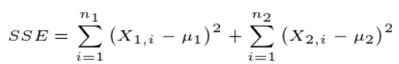
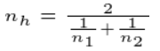
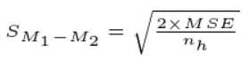
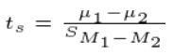
Simple example: Efficacy of alternative drugs
Step 5: Decide a significance level, alpha, say 0.05.
Step 6: Compute the difference in group means, μd = μ1 - μ2.
Step 7: Compute the Sum-of-squares-error (SSE)
Step 8: Compute MSE by dividing SSE by degrees of freedom. DOF= (n₁-1)+(n₂-1)
Step 9: Compute harmonic mean of the sample sizes:
Step 10: Compute standard error of the difference of means:
Step 11: Compute the test statistic by dividing the difference in means by this standard error quantity:

Slide 36
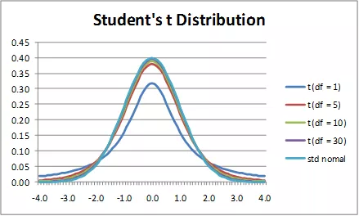
Simple example: Efficacy of alternative drugs
Step 12: Now it is time to do the real hypothesis testing. We compute the probability of observing having the observed test statistic as large or as small given a t-distribution with the degrees of freedom same as the problem. Note that if the DOF is > 30, then we can just use the standard normal distribution.
Step 13: If the probability is < alpha then we can reject the NULL hypothesis and conclude there is really a statistically significant difference between the group means.

Slide 37
Tukey HSD test for multiple groups
For more than two groups, we can always do pairwise comparison in all possible combination, build a table, and analyze that.
However, this enhances the chance of making an overall Type-I error as such an error can happen in any one of the tests.
There is a special method called Tukey HSD (Honestly Significant Difference) test which can avoid this.
However, there is also a widely used method for testing a global NULL hypothesis: If all the group means are equal, by analyzing the variance of the groups. It is called ANOVA for Analysis Of Variance.

Slide 38
ANOVA
ANOVA is based upon a simple intuition: that a ratio of between-group-variability and within-group-variability can be used to infer whether all the group means are equal.
Look at the following illustration and ask yourself: In which of the cases, you are more confident of concluding that means of three groups are truly different?

Slide 39
ANOVA and the F-test
ANOVA is based on two estimates of the population variance (σ²). One estimate is called the mean square error (MSE). Another is called the mean square between (MSB).
MSE is based on differences among scores within the groups and estimates σ² regardless of whether the null hypothesis is true (the population means are equal).
MSB is based on differences among the sample means and only estimates σ² if the population means are equal. If the population means are not equal, then MSB estimates a quantity larger than σ².
Therefore, if the MSB is much larger than the MSE, then the population means are unlikely to be equal.
We compute this ratio between MSB and MSE, and since this is a ratio of the estimate of variance, it follows a special distribution called F-distribution (named after R. Fisher). So, we do a F-test in ANOVA.

Slide 40
ANOVA and linear regression
ANOVA is a special case of linear regression with one response variable and multiple categorical predictors - each category representing a group.
The principle of ANOVA and F-test procedure can be used in regression modeling, to test in the so-called ‘Overall significance test’.
We will discuss this in more detail when we talk about linear regression, but for now think that ANOVA will determine whether it was worth doing the regression at all i.e. it will tell us if at least one of the regression coefficients are non-zero (vs. the possibility that all of them are zero and the model is useless).

Slide 41
Conditional probability, Bayes’ rule
Dr. Tirthajyoti Sarkar
August 31st, 2019

Slide 42
Some intuitive notes and observations
Tests are not the event. We have a cancer test, separate from the event of actually having cancer.
Tests are flawed. Tests detect things that don’t exist (false positive), and miss things that do exist (false negative). People often use test results without adjusting for test errors.
False positives skew results. Particularly, if you are searching for something really rare (1 in a million).
People prefer natural numbers. Saying “100 in 10,000″ rather than “1%” helps people work through the numbers with fewer errors.

Slide 43
What can Bayes’ rule do?
Bayes’ theorem converts the results from your test into the real probability of the event. For example, you can:
Correct for measurement errors. If you know the real probabilities and the chance of a false positive and false negative, you can correct for measurement errors.
Relate the actual probability to the measured test probability. Given mammogram test results and known error rates, you can predict the actual chance of having cancer given a positive test.

Slide 44
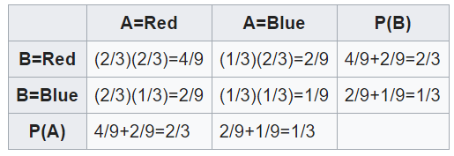
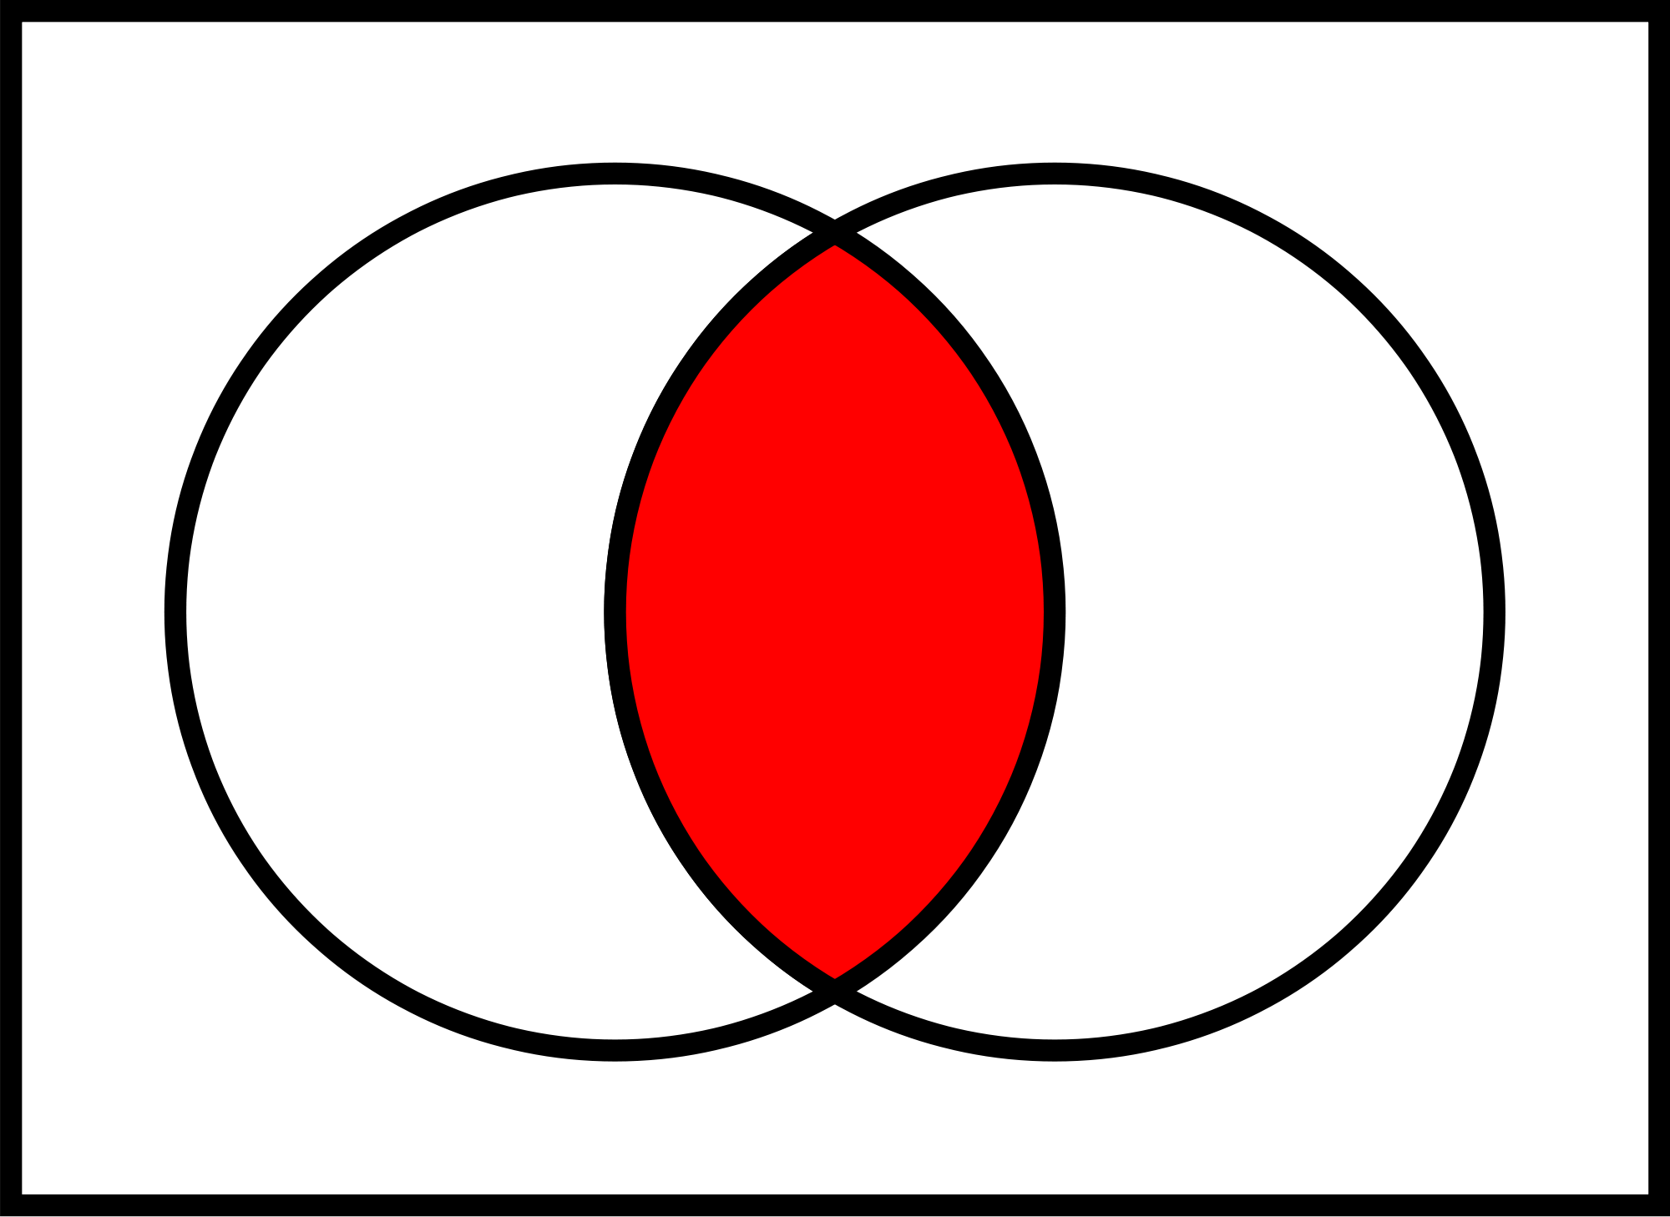
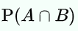
Joint probability concept
Joint probability: It is the likelihood of two independent events happening at the same time. Joint probabilities can be calculated using a formula as long as the probability of each event is known.
Suppose each of two boxes contains twice as many red balls as blue balls, and no others, and suppose one ball is randomly selected from each urn, with the two draws independent of each other.
Let A and B be discrete random variables associated with the outcomes of the draw from the first urn and second urn respectively. The probability of drawing a red ball from either of the urns is 2/3, and the probability of drawing a blue ball is 1/3.
Think of set intersection

Slide 45
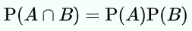
Concept of independence
In probability theory, two events are independent, statistically independent, or stochastically independent if the occurrence of one does not affect the probability of occurrence of the other (equivalently, does not affect the odds).
Similarly, two random variables are independent if the realization of one does not affect the probability distribution of the other.
The concept of independence extends to dealing with collections of more than two events or random variables, in which case the events are pairwise independent if each pair are independent of each other, and the events are mutually independent if each event is independent of each other combination of events.

Slide 46
Concept of conditional probability
In probability theory, conditional probability is a measure of the probability of an event occurring given that another event has occurred.
If the event of interest is A and the event B is known or assumed to have occurred, "the conditional probability of A given B", or "the probability of A under the condition B", is usually written as P(A | B), or sometimes PB(A) or P(A / B).
For example, the probability that any given person has a cough on any given day may be only 5%. But if we know or assume that the person has a cold, then they are much more likely to be coughing.
The conditional probability of coughing by the unwell might be 75%, then: P(Cough) = 5%; P(Cough | Sick) = 75%

Slide 47
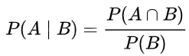
Combining joint and conditional probabilities
It is relatively straightforward, conceptually, to combine the notions of joint and conditional probabilities into what is called marginalization.
If we know the conditional probability of P(A|B), then what information is needed to compute P(A ∩ B)?
We can reason that probability of “event A ∩ B” is the joint probability of the “event A|B” and “event B”. This is called marinalizing B out.
So, P(A ∩ B) = P(A|B, B) = P(A|B).P(B) if A|B and B are independent (which is true in almost all cases).

Slide 48
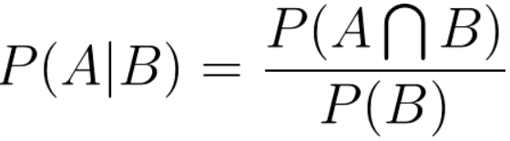
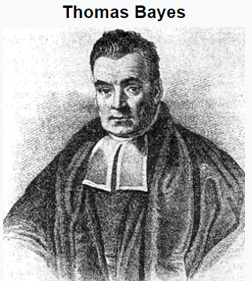
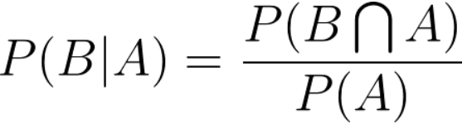
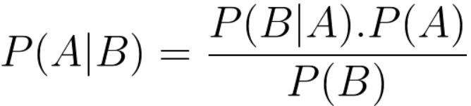
Bayes’ rule/theorem
So, we saw
They are the same!
Interchanging A and B
Bayes’ theorem (alternatively Bayes’ law or Bayes’ rule) describes the probability of an event, based on prior knowledge of conditions that might be related to the event. For example, if a disease is related to age, then, using Bayes’ theorem, a person's age can be used to more accurately assess the probability that they have the disease, compared to the assessment of the probability of disease made without knowledge of the person’s age.

Slide 49
Bayesian inference, network and advanced topics
Dr. Tirthajyoti Sarkar
August 31st, 2019

Slide 50

A new way of doing data science and learning...
Posterior
Likelihood
Prior
We start with a hypothesis.
Then, we gather data, and update our initial belief.
If the data supports the hypothesis then the probability goes up, if it does not match, then probability goes down.
But in majority of statistical learning, the notion of Prior is not used or not looked favorably.
Also, the computational intricacies of Bayesian learning has prevented it from being mainstream for more than two hundred years.
But things are changing now...
Marginalization
We have a starting model. We will update with the more data as they come in.
Notes:
Traditional streaming learning is not the same. As more data comes in, we just do a bigger matrix multiplication. But do we construct probabilities over time looking at the data?

Slide 51
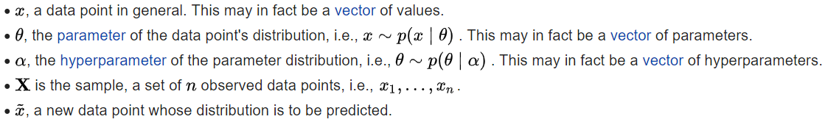
Bayesian inference
With the Bayesian probability interpretation, the theorem expresses how a degree of belief, expressed as a probability, should rationally change to account for availability of related evidence.
This, in fact, is the only rational way of incorporating the so-called ‘expert knowledge’ into the machinery of machine learning.
Expert knowledge
Notes:
Deep learning example. We do random weights initialization and just learn from the data only. No incorporation of prior knowledge. Just instant learning.

Slide 52

Example in plain words
You start tossing a coin. You see {H, T, H, H}. What is the probability of the next toss?
You will notice that nothing you have been taught so far, enables you to answer this question. The best guess you can give is the probability of next toss is {H:0.5, T:0.5}.
Because the frequentist’s probability definition is contingent on getting a large number of data and then calculating probabilities as a ratio. It can answer question like, “what is the probability of a tail given 100,000 coin toss”? But not “what is the probability given a small number of observation and how that probability changes with every toss”.
This kind of questions arises in medical diagnosis, rare events, where we need to start predicting as soon as the observation comes in.
Notes:
You start with a prior belief that the coin is fair, H:0.5, T:0.5. As soon as you see a Head in the first toss, this belief can be updated with HEAD probability going up and TAIL going down. So, the probability changes with every data point, not waiting for a large volume of data to be collected and then processed at once.

Slide 53
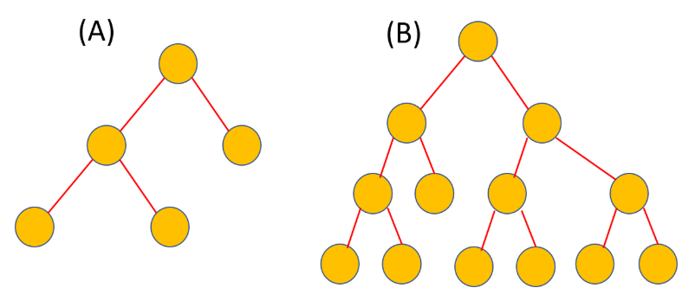
Why this line of thinking is important
Why do we care about computing probability of hypothesis (posterior), given data?
Because machine learning is full of hypotheses - when you do a linear regression, you make an hypothesis about the model structure and the error terms’ distribution.
When we do a decision tree learning, you make an assumption about the structure of the tree. We also assume that shallower trees are more general.
?
Left tree is expected to produce a function with less free parameters and will produce a less complex classification boundary.
Notes:
Bayesian inference has been applied to genetics, linguistics, image processing, brain imaging, cosmology, machine learning, epidemiology, psychology, forensic science, human object recognition, evolution, visual perception, ecology, and even the work of the fictional detective Sherlock Holmes.

Slide 54
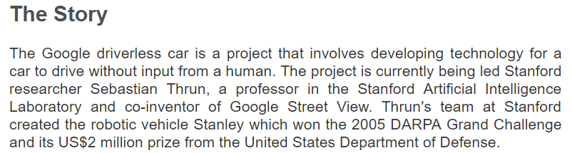
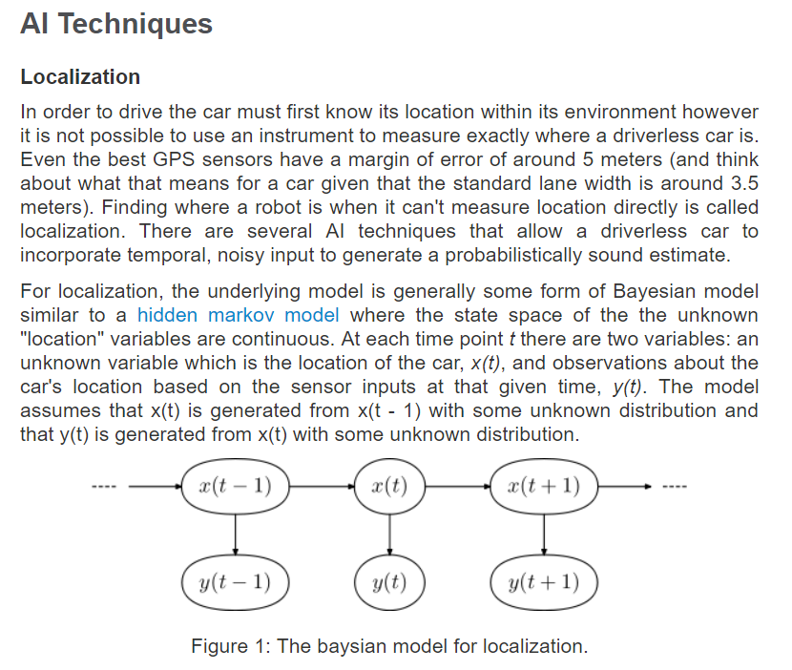

The original autonomous vehicle
https://stanford.edu/~cpiech/cs221/apps/driverlessCar.html

Slide 55
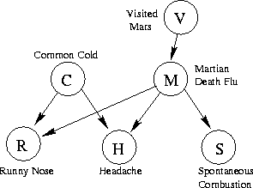
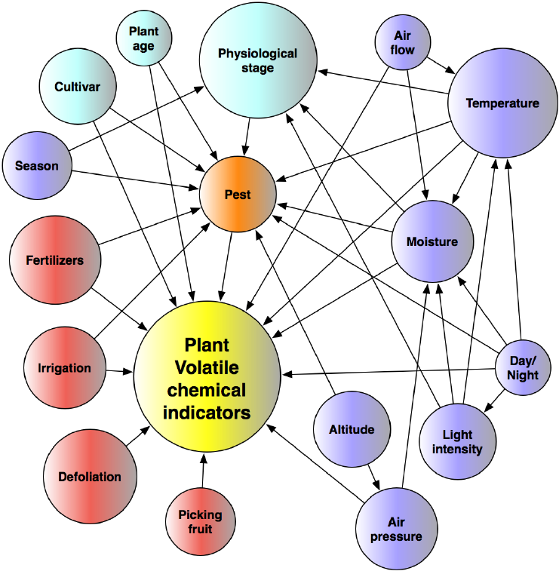
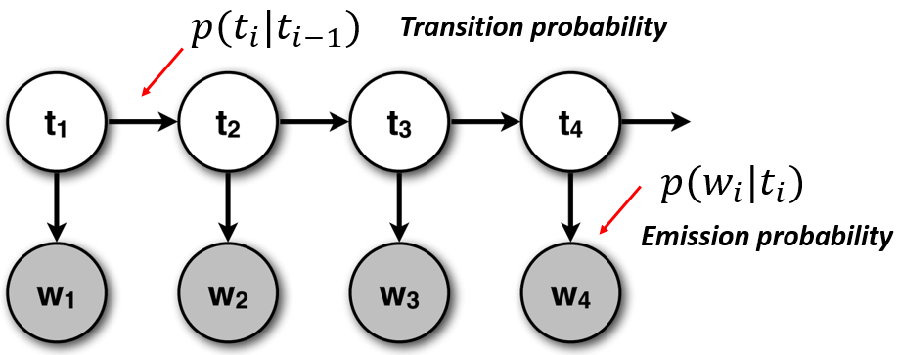
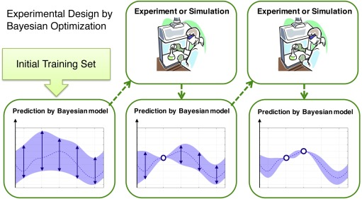
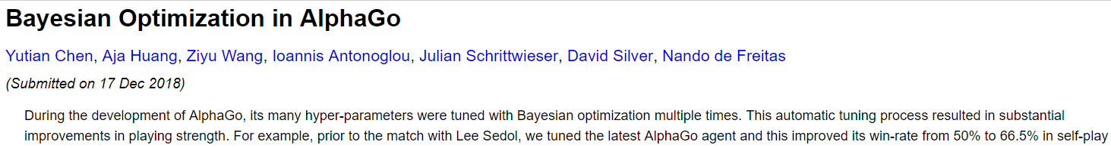
Bayesian network and optimization

Slide 56
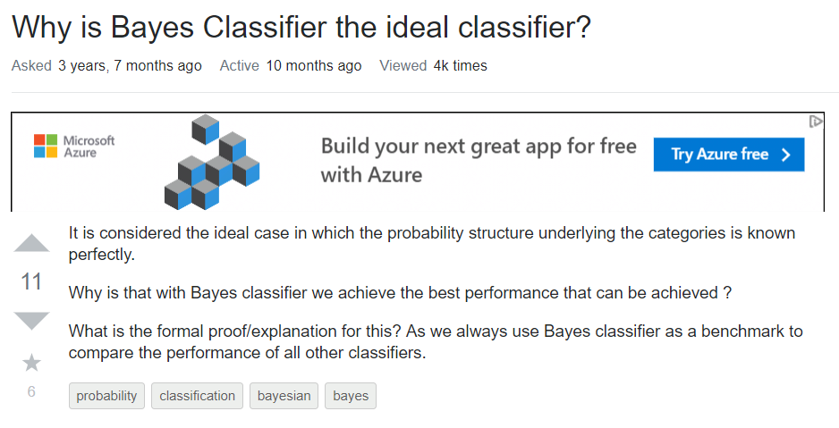
Bayes optimal classifier
Bayes Optimal Classifier (BOC), or simply termed as Bayes Classifier is a classifier that minimizes the error in a probabilistic manner.
Usually, when we calculate the error in a classifier, let's say a binary classifier, we sum up all the mismatches wherein each mismatch (in the predicted class and the actual class) is considered as 1.
If it is bayes optimal, then the errors are weighed using the join probability distribution between the input and the output sets. This means, that we sum up the mismatches, each error (1) is weighted by the probability of the corresponding input and the predicted output (the incorrect output here).

Slide 57
Let’s see some examples with Python
We will start by working out simple examples involving coin toss to get a feel about how this mechanism works.
Thereafter, we will take a drug testing example and see how Bayesian thinking is essential to get the best possible estimate of the probability in the presence of known errors in the test. We will also work out a factory production example for common in quality assurance setting.
We will also examine some advanced packages like PyMC3 which does Markov Chain Monte Carlo (MCMC) sampling to compute Bayesian inference. But these will just be mentioned for your knowledge and not covered in detail here.

